Slide 1
Database Applications and Information Systems
Topic: ER-to-Relational Mapping
Dr. Dan Lin

Slide 2
Announcement
Oct 1
  Midterm review
Oct 8
  Midterm exam

Slide 3
Brief Review
ER and EER model
  Entity
  Weak entity
  Relationship
  Superclass / subclass

Slide 4
Mapping of Regular Entity Types
Entity sets become relations with the same set of attributes.
  Primary key of the entity set becomes primary key of the relation
  Composite attributes: keep its simple component attributes in the relation
  Multivalued attributes: create a new relation for each individual attribute.

Slide 5
Entity Set -> Relation
name
manf
Beers
name manf
Miller xxx
Bud yyy
Beers
Relation: Beers(name, manf)

Slide 6
Example
Mn
Fn
Ln
name
height
ID
Students
phone
PreviousDegrees
college
year
degree
field

Slide 7
Example
Mn
Fn
Ln
Relation Schema
name
height
Students(ID,height,Fn,Mn,Ln)
ID
Students2(ID,phone)
Students
phone
Students3(ID,college,year,degree,field)
PreviousDegrees
college
year
degree
field

Slide 8
Multivalued attributes
Students2
For each multivalued attribute, create a new relation R.
The attributes in the new relation R include the primary key of the entity set and the multivalued attribute.
The primary key of R is the combination of all attributes in R.
Need to specify the foreign key constraint!
ID Phone
001 1235
001 2243
002 1093
003 3417
003 4501

Slide 9
Weak Entity -> Relation
number
name
studioname
address
N
1
Crew
WorkFor
Studio
year

Slide 10
Weak Entity -> Relation
number
name
studioname
address
N
1
Crew
WorkFor
Studio
year
Studio(studioname,address, year)
Crew(studioname, address, number, name)
CS2300 - Dan Lin

Slide 11
Mapping of Weak Entity Types
The mapping of attributes in a weak entity type is similar to that of the regular entity types.
The difference is that each relation of a weak entity type needs to include the primary key of its owner entity type.
Then the primary key of each relation of the weak entity type is the combination of the primary key(s) of the owner(s) and the partial key of the weak entity type, if any.

Slide 12
Mapping of Relationship Set
CS2300 - Dan Lin

Slide 13
Relationship Set -> Relation
name
addr
name
manf
Drinkers
M
Likes
N
Beers
comment
CS 2300 - Dan Lin

Slide 14
Relationship Set -> Relation
name
addr
name
manf
Drinkers
M
Likes
N
Beers
comment
Likes (Drinker, Beer, comment)

Slide 15
Mapping of Relationship Set
General approach:
  A relationship becomes a relation R whose attributes are only:
    The primary keys of the connected entity sets.
      May need to rename some attributes.
    Attributes of the relationship itself.
  The primary key of the relation R is the combination of the primary keys of the connected entity sets.
  Need to specify foreign keys!

Slide 16
Multiway Relationship Set
name
addr
name
manf
Bars
Beers
license
Preferences
Drinkers
name
addr

Slide 17
Multiway Relationship Set
Preferences
name
addr
name
manf
Bar Drinker Beer
Joe’s Bar Ann Miller
Sue’s Bar Ann Bud
Sue’s Bar Ann Pete’s Ale
Joe’s Bar Bob Bud
Joe’s Bar Bob Miller
Joe’s Bar Cal Miller
Sue’s Bar Cal Bud Lite
Bars
Beers
license
Preferences
Drinkers
name
addr
Preferences(Bar, Drinker, Beer)

Slide 18
Mapping of Super/Subclass

Slide 19
Mapping of Super/Subclass Relationship
General approach: Create a relation for each class; include the primary key of the superclass in the subclass.
name
manf
Beer
Ale
color

Slide 20
Mapping of Super/Subclass Relationship
General approach: Create a relation for each class; include the primary key of the superclass in the subclass.
Beers
name
manf
name manf
Bud Anheuser-Busch
Summerbrew Pete’s
Ales
name color
Summerbrew dark
Beer
Ale
color

Slide 21
Mapping of Super/Subclass Relationship
Approach 2: Create relations for subclasses only.
This approach works only when every entity in the super class is included in at least one sub-class.
Need to include the attributes in the superclass into each relation.
An entity may be duplicated in several relations.

Slide 22
price
License#
owner
Vehicle
Number_of_passenger
d
weight
Car
Truck

Slide 23
price
License#
owner
Vehicle
Number_of_passenger
d
weight
Car
Truck
Car(License#, price, owner, Number_of_passenger)
Truck(License#, price, owner, weight)

Slide 24
Mapping of Super/Subclass Relationship
Approach 3: Create a single relation including all attributes in the superclass and the subclasses.
Add one or more type attributes to indicate the subclass to which each tuple belongs to
The primary key of the relation is the primary key of the superclass.
May generate many NULL values if many specific attributes exist in the subclass

Slide 25
price
License#
owner
Vehicle
Number_of_passenger
d
weight
Car
Truck

Slide 26
price
License#
owner
Vehicle
Number_of_passenger
d
weight
Car
Truck
Vehicle (License#, price, owner,
Number_of_passenger, weight, flag)

Slide 27
Some Issues
For a shared subclass, we can use any of the three approaches.
  Its superclasses must all have the same primary keys.
For a multi-level specialization, we do not need to follow the same mapping option for all the specializations.

Slide 28

Example

Slide 29
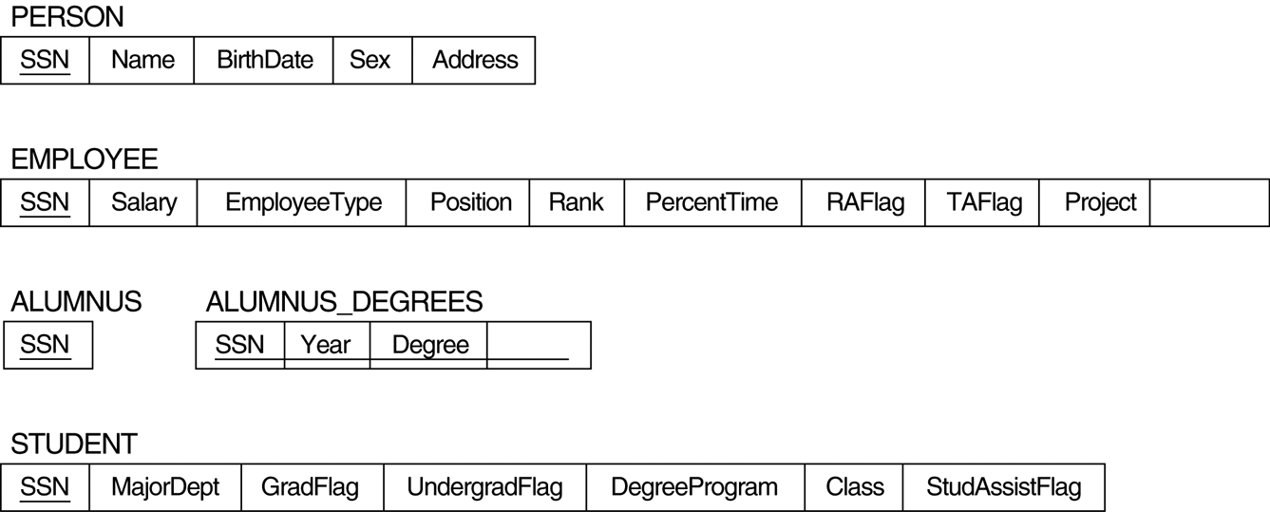
One Possible Mapping
course

Slide 30
What’s next…
SQL

